Slide 1


FDA Adverse Reactions Analysis
Chloe Schnydman and Rahma Semma

Slide 2

Background
The FDA’s FAERS (FDA Adverse Event Reporting System) database collects voluntary reports of adverse drug reactions from healthcare providers, patients, and manufacturers.
It serves as a critical resource for detecting new safety concerns, understanding drug risks, and making regulatory decisions.

Slide 3
Disclaimer
These are associations, not causation. It’s possible:
Deaths are more commonly reported with certain drugs due to the conditions they treat (e.g., cancer vs. allergy).
Some drugs appear “safer” because they’re used in healthier populations.

Slide 4
Dataset
This is only the last Quarter of 2024
There are 6 datasets in this database:
Demographic and administrative information and the initial report image ID number (Demo)
Drug information from the case reports (Drug)
Reaction information from the reports (Reac)
Patient outcome information from the reports (Outc)
Information on the source of the reports (Rpsr)
Drug therapy start dates and end dates from the reports (Ther)
Only wanted to focus on Drug, Reac, and Outc

Slide 5
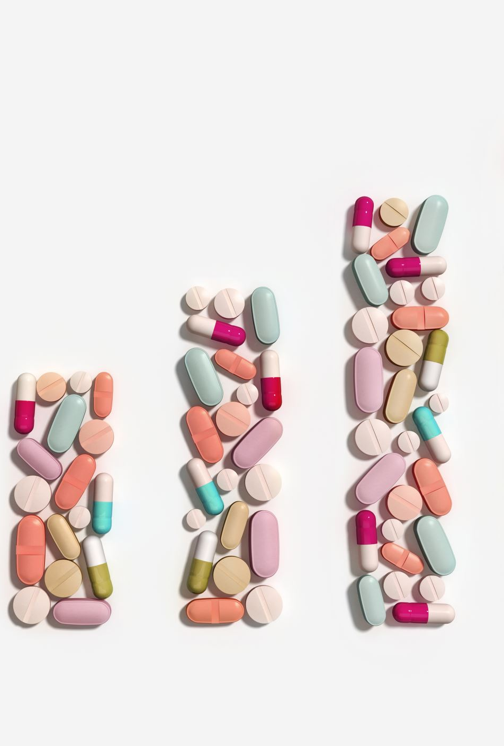
Purpose Of Project
The purpose of this project is to analyze adverse drug reactions in the fourth quarter of 2024. This analysis aims to:
1. Identify patterns and trends in adverse reactions related to various drugs
2. Determine which drugs are associated with severe or common adverse reactions
3. Examine demographic factors that may influence the likelihood or severity of reported reactions
4. Provide insights for healthcare professionals and regulatory agencies to improve drug safety and post-market surveillance.

Slide 6
Methods And Models
Merged Drug, Outcome, and Reactions datasets on FAERS report id
Dropped patients who were taking multiple drugs at a time to focus on specific drug reactions and not deal with the reactions that could be affected by taking multiple at a time
Preprocessed with one-hot encoding
Used Python (pandas, seaborn, sci-kit-learn)
visualized the top 10 drugs and adverse events via a heatmap to evaluate predictors of serious outcomes
built a decision tree classifier (max depth = 3) to illustrate how specific PTs and drugs contribute to the classification of serious versus non- serious reports.
Models were evaluated on interpretability and visual clarity

Slide 7
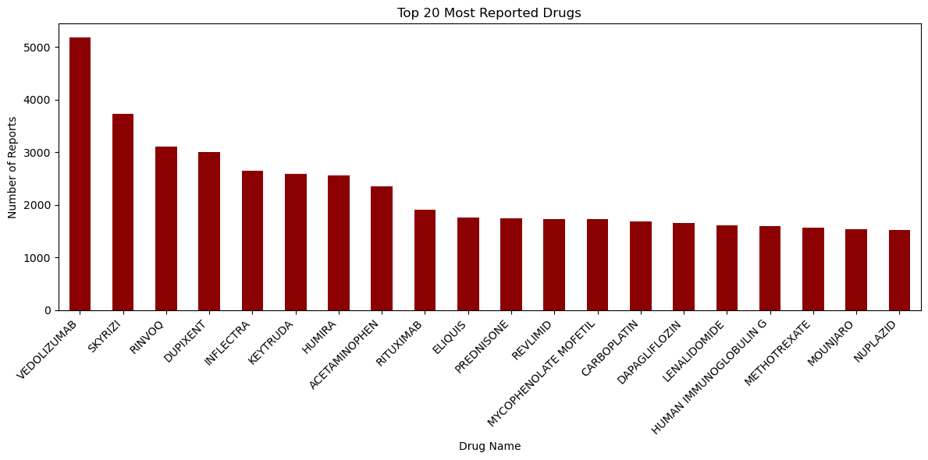
Top 20 Most Reported Drugs
The most reported drugs are Vedolizumab, Skyrizi and Rinvoq.
Vedolizumab: Treatment for ulcerative colitis (UC) and Crohn’s disease (CD)
Skyrizi: Plaque psoriasis treatment
Rinvoq: Treatment for various inflammatory conditions

Slide 8
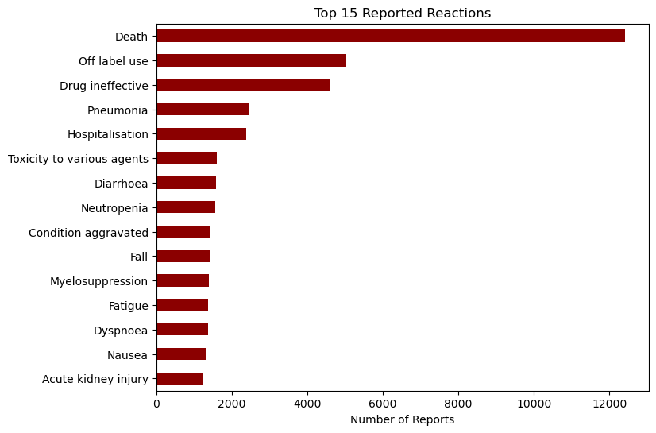
Top 15 Reported Reactions
Off label use: prescribed to take something, but taking it for something else

Slide 9
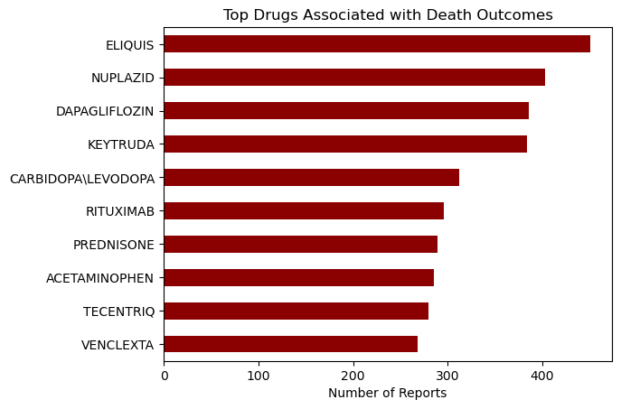
Top Drugs Associated with Death Outcomes
The drugs most associated with death are Eliquis, Nuplazid and Dapagliflozin.
Eliquis: Blood thinner
Nuplazid: Antipsychotic for Parkinson’s disease psychosis
Dapagliflozin: Treatment for type 2 diabetes, heart failure, and chronic kidney disease

Slide 10
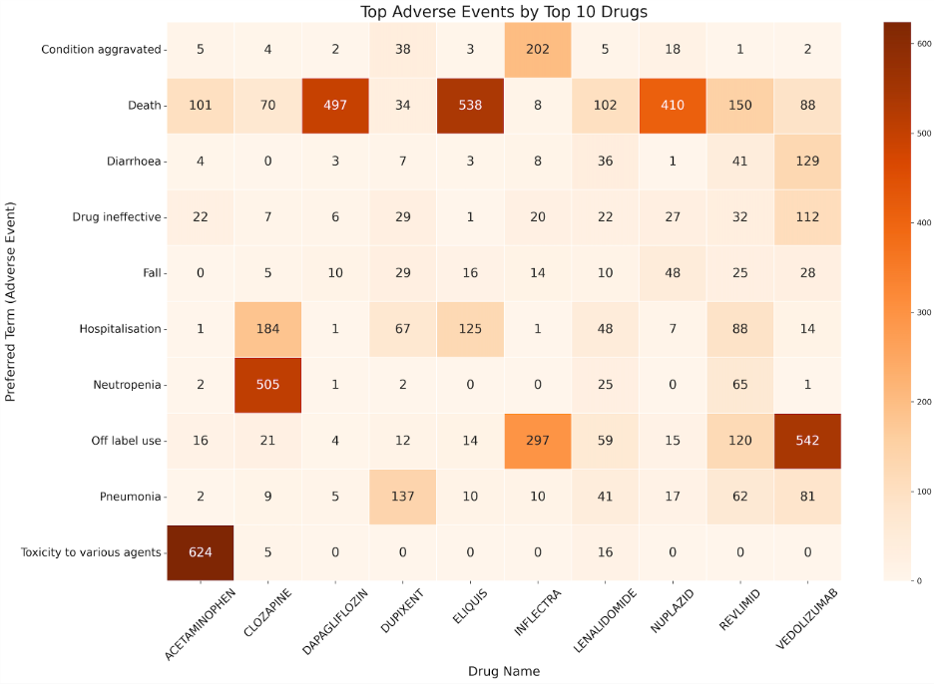
Heatmap
Acetaminophen (624): Toxicity to various agents
Vedolizumab (542): Off label use
Eliquis (538): Death
Clozapine (505): Neutropenia
Dapagliflozin (497): Death
Nuplazid (410): Death
Neutropenia: low levels of Neutrophiles (white blood cells)

Slide 11
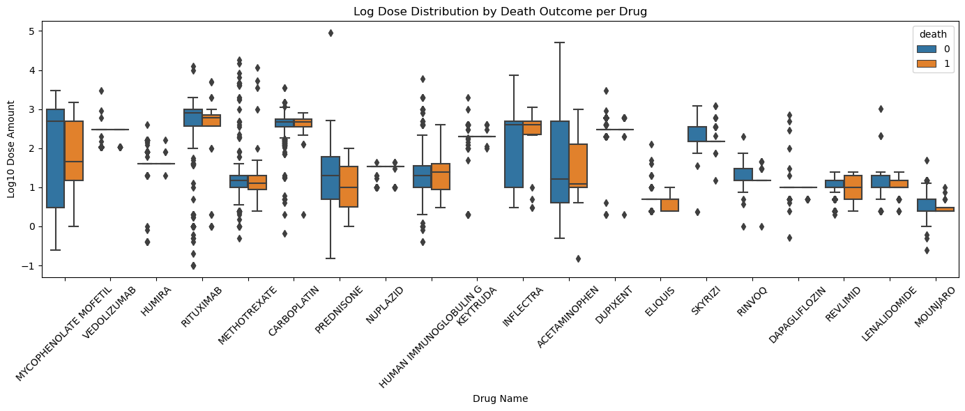
Dosages by Death Outcome per Top 20 Drugs
Model does well in identifying non-death cases (Class 0).
It struggles with precision on death cases (Class 1): when it predicts a death, it's often wrong.
However, recall for deaths is strong (0.70) — it captures 70% of real deaths.
This trade-off is expected in imbalanced data, and you did the right thing using class_weight='balanced'.

Slide 12
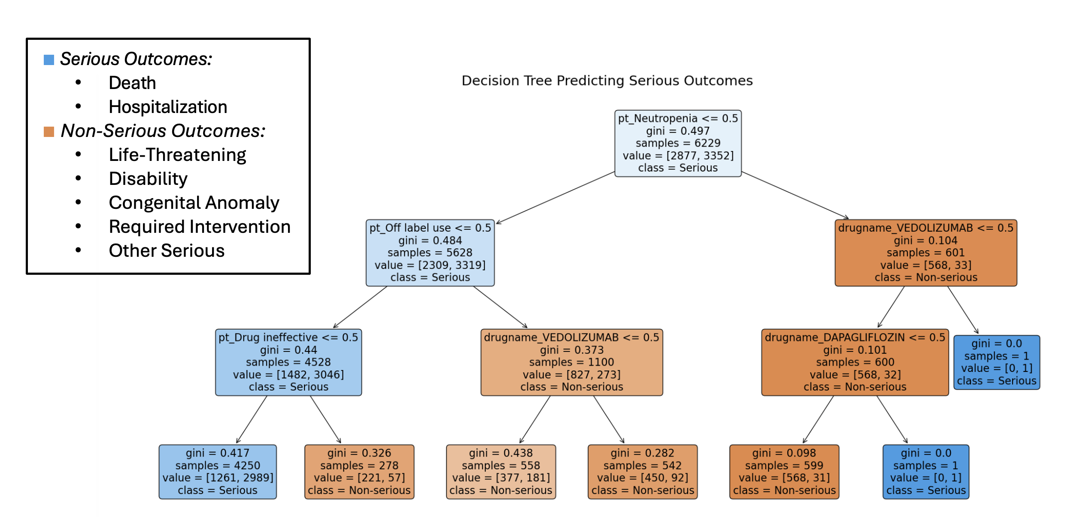
Decision Tree Predicting Serious Outcomes
Vedolizumab is strongly associated with non-serious outcomes.
Dapagliflozin almost always leads to non-serious outcomes (Gini ≈ 0.1).
Off-label use and Drug ineffective are important features that separate serious from non-serious cases.
Nodes with lower Gini and larger sample size indicate stronger and more confident predictions.
Notes:
Gini: A measure of impurity (0 = pure, 0.5 = mixed)
Samples: Number of records that reached this node
Value: [# non-serious, # serious] outcomes
Class: Predicted class at that node (Serious or Non-serious)

Slide 13
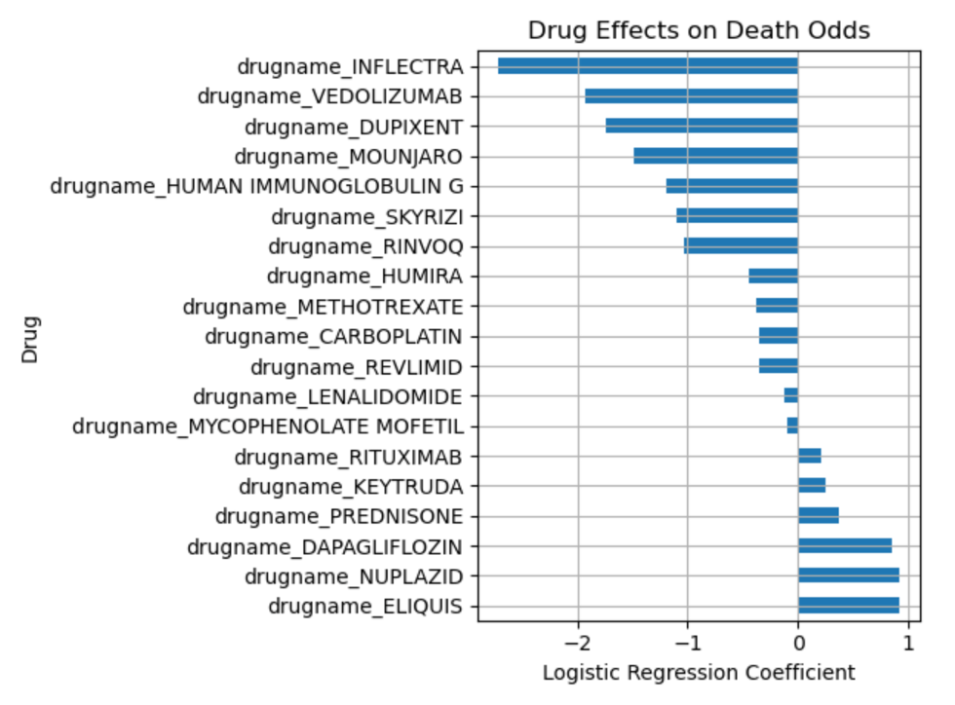
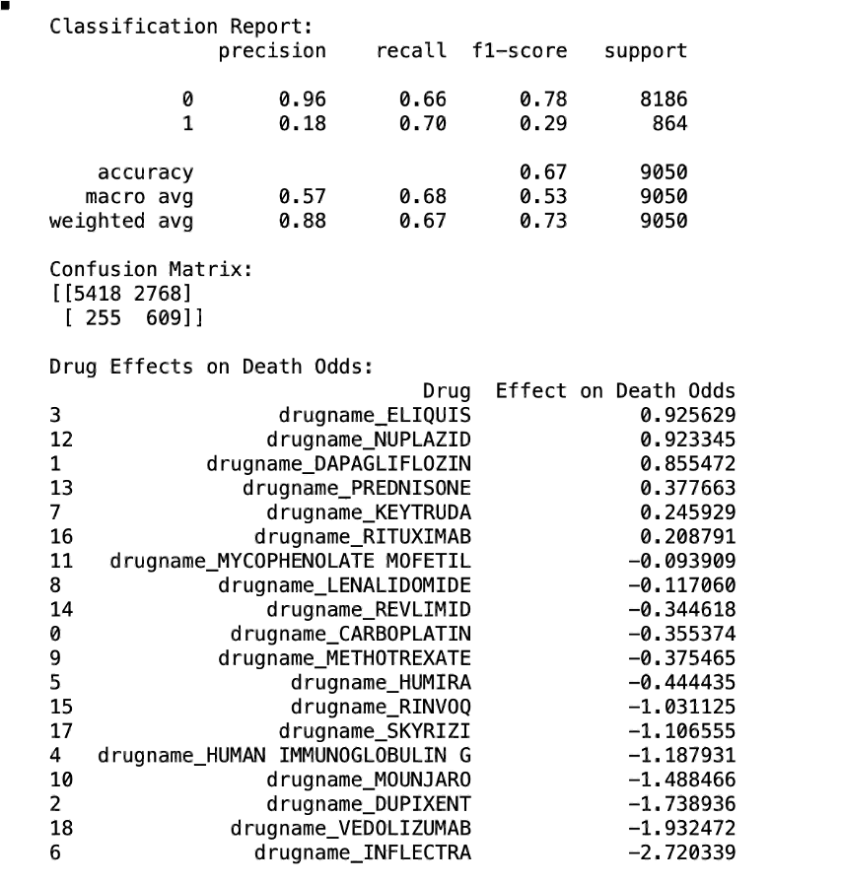
Drug Effects On Death Odds Logistic Regression And Its Coefficients
This shows how much each drug affects the odds of death, with:
Positive coefficients → increase the odds of death
Negative coefficients → decrease the odds of death
Drugs with Highest Positive Coefficients (↑ Death Odds):
Eliquis, Nuplazid, and Dapagliflozin were most strongly associated with death (at least in this report data).
Drugs with Strong Negative Coefficients (↓ Death Odds):
Inflectra, Vedolizumab, and Dupixent were associated with lower death odds in your dataset.
Model found them more often in non-death cases

Slide 14
Ethical Considerations
Informed Consent & Data Collection:
The FAERS data is collected voluntarily by healthcare providers, patients, and manufacturers.
While not obtained directly from patients, ethical research involves acknowledging the limitations of voluntarily reported data and ensuring the data is used for legitimate scientific purposes.
Bias & Limitations of Voluntary Reporting:
Selection Bias:
Reports are more likely to include serious or unusual adverse events rather than common, mild reactions.
Underreporting is a significant limitation that can skew findings.
Reporting Bias:
Reports may be influenced by media coverage, legal actions, or manufacturer promotions.
Data cleaning and analysis should account for potential biases where possible.

Slide 15
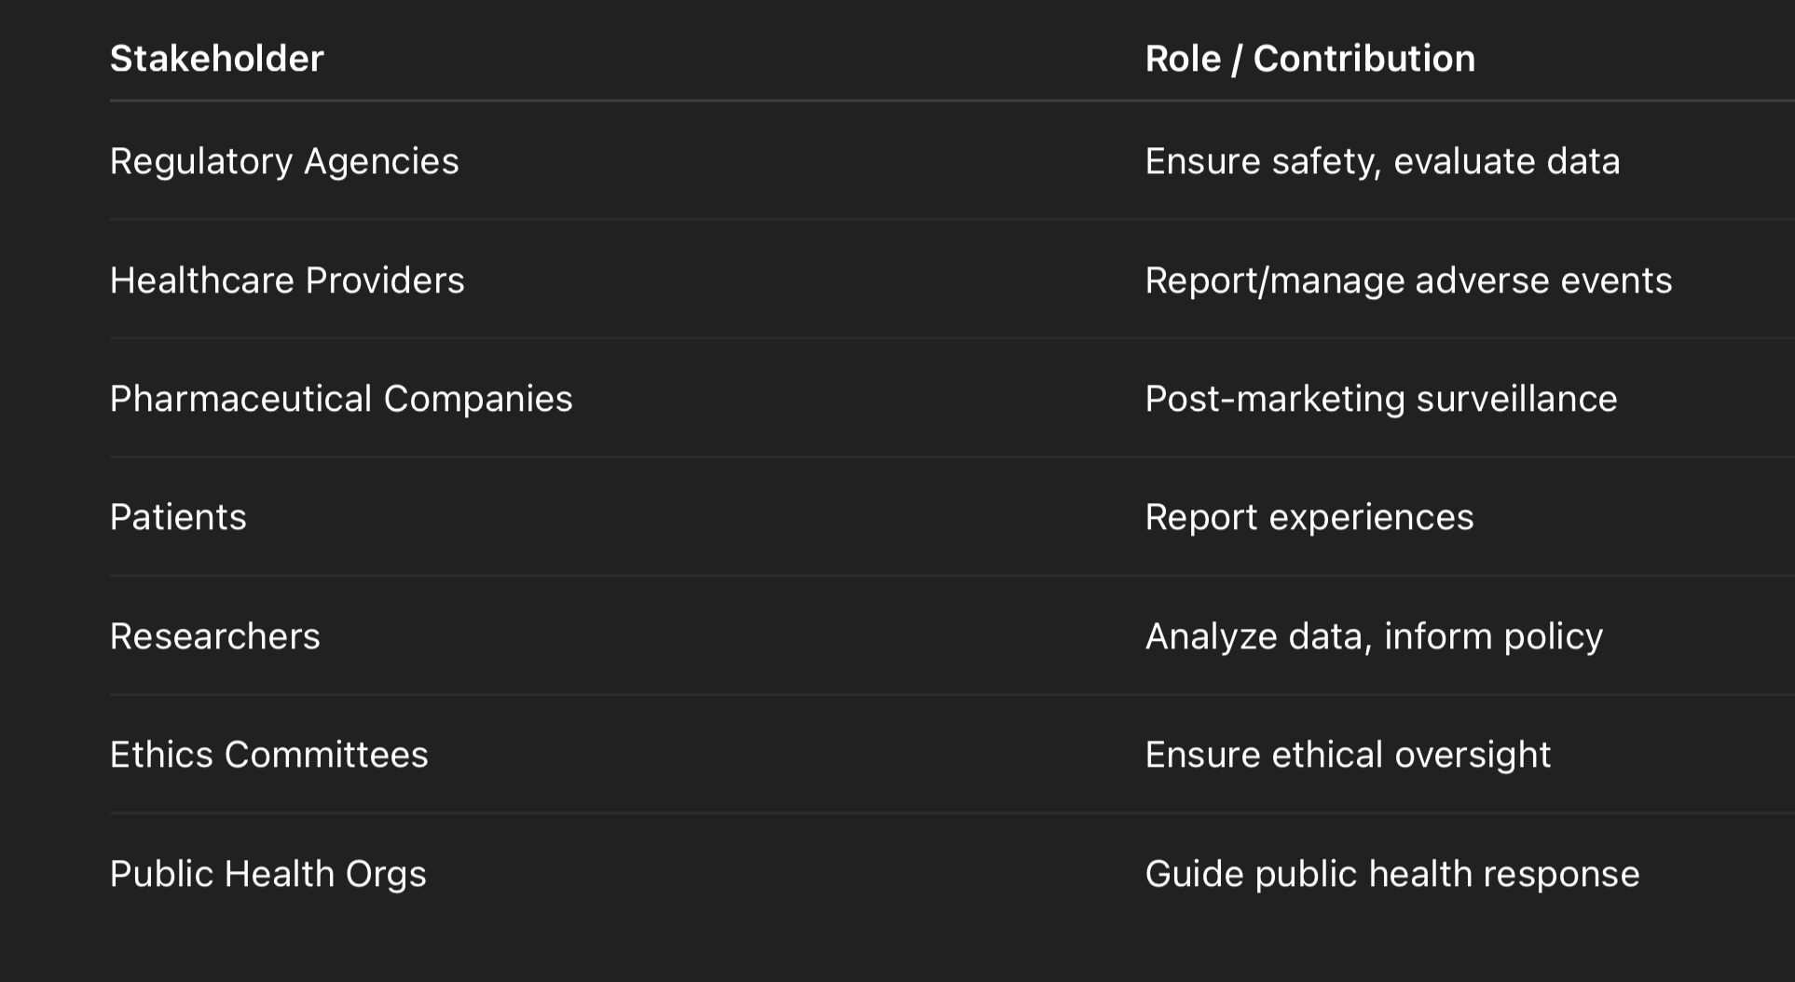
Stakeholders
Notes:
Rahma

Slide 16
Conclusion
A handful of drugs, such as Eliquis and Humira, were responsible for a disproportionate number of adverse event reports, suggesting their widespread use and potential safety concerns.
Among reported reactions, “Death,” “Off-label use,” and “Drug ineffective” stood out not only in frequency but also in severity, emphasizing the importance of monitoring treatment effectiveness and proper usage.
Note: Most of these drugs are highly advertised!!

